Slide 1


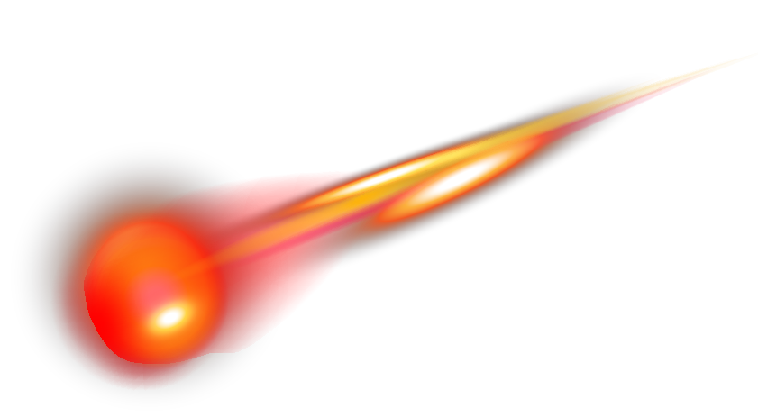
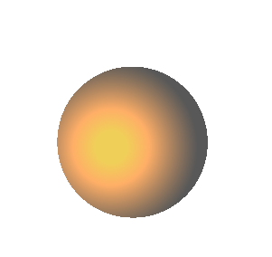

Team 9: Study of geographic hotspots for meteorite falls and mass variations
Notes:
Hello my name is Aleksandar Jeremic, I will be presenting for team number 9, Our project covers a dataset from NASA, we took this data set and are looking for interesting information of geographic hotspots and mass variation.

Slide 2
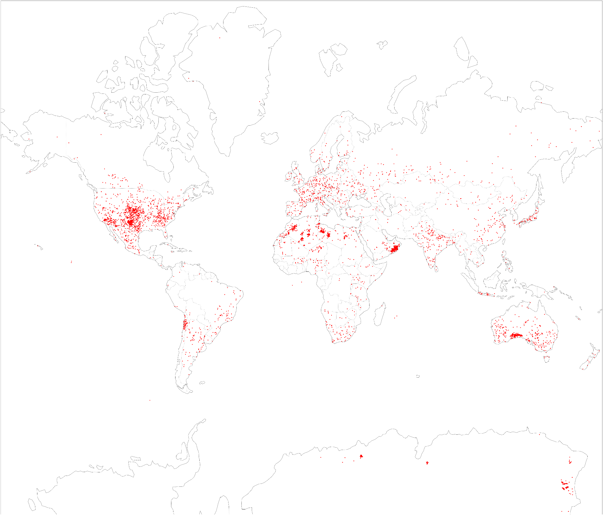
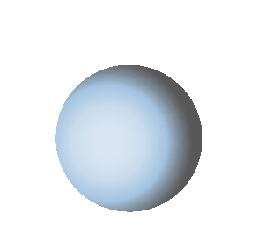
Meteorite
Landings
Notes:
Here we can see a map of the world, each dot represents a meteorite that was found. We can see some large clusters in central United States near Texas and the midwest. We also notice a lot of meteorites found in northern Africa and the region around Oman.

Slide 3
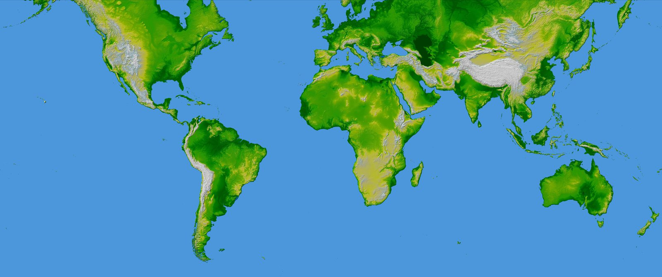
Height above
sea level
Notes:
Here we see a topological map overlaid on top of our scatter plot of the meteorites, the darker the color the lower the height in sea level. We see a trend with lower height above sea level and the number of found meteorites. There exist other factors which influence the number of meteorites found which can include, population density, it’s easier to find meteorites when there are more people there. The climate and biome of the region, a flat desert makes it much easier to see a meteorite than in a jungle, for instance the amazon rainforest has almost no meteorites discovered. And finally the likelihood of someone reporting the meteorite as found, in some cases someone can stumble upon meteorites and either don’t know what they've found or don’t have an easy way to express the information.

Slide 4

Motivation
Meteorites that land on Earth provide valuable insights into the materials that shaped planets in the distant past.
Studying meteorites allows us to explore the early history of our solar system, including the ages and compositions of different planetary building blocks [1].
Additionally, meteorite hunters such as Roberto Vargas of Bristol find meteorites that are worth over $100,000. He has a personal collection of 500+ meteorites [2]. Our data-driven results could be helpful to the collectors to find more meteorites.
[1] https://science.nasa.gov/solar-system/meteors-meteorites/facts/
[2] https://www.youtube.com/watch?v=IDvkbsTcuVE
Notes:
By studying meteorites that land Earth, we can learn more about the materials that shaped planets in the past. We can also learn about the history of solar system by studying the ages and composition of the meteorites. Moreover, our data-driven results could be helpful to meteorite hunters and collectors to find more meteorites.

Slide 5
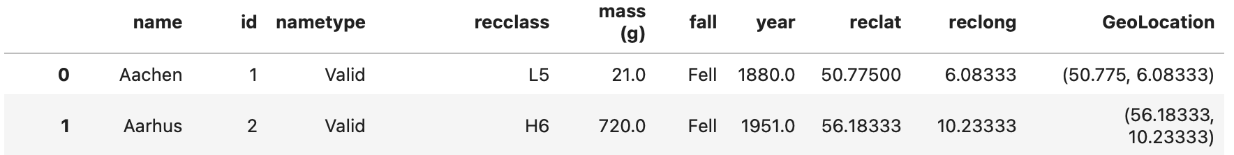
Dataset Overview
The dataset contains the name, ID, name type, class, mass (g), fall year, latitude, longitude, and GeoLocation of meteorites.
The size of the dataset is 45716 rows x 10 columns
This comprehensive data set from NASA contains information on all of the known meteorite landings.
Source:
https://urldefense.com/v3/__https://catalog.data.gov/dataset/meteorite-landings__;!!Mih3wA!Hd08YAuxPfMw9Aq0REGhTCUVq6oSV1ykEDkGUO6aRpEaztgLmKBRgzVr0BWbfUpxhU-q8FohTTRuQnJQI65-$
Notes:
Let’s take a look at the dataset. The dataset has important attributes such as name, class, mass, fall year, and geo location of the meteorites. The size of the dataset is 45716 rows by 10 columns. This dataset is from NASA, and it has all the known meteorite landings. For Preprocessing we needed to check through all columns making sure we aren't using garbage data, such as geographic location set to (0,0). We also created a new data set that involves a new column called Continent, this column maps the geographic information (longitude and latitude) to whichever continent that falls under.

Slide 6
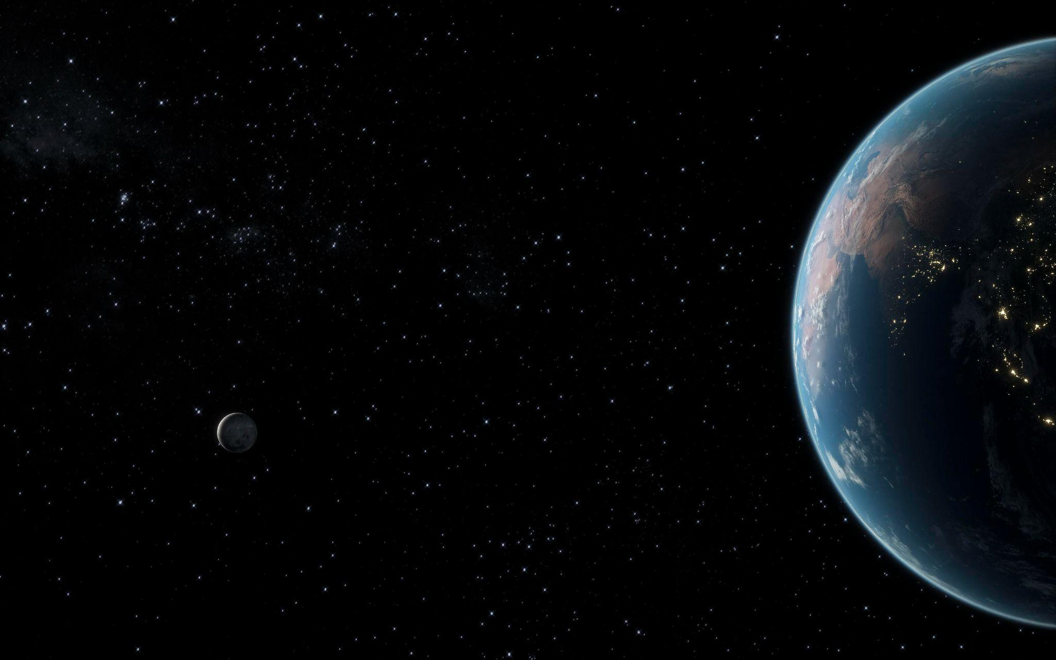

Let’s Talk
about
Meteorite Classes
Most common classes
&
Least common classes
Classes
based on
Average Mass
Notes:
Now, we are going to look at classification of meteorites based on (1)Most common class & Least Common Class (2) Average mass of the meteorites.

Slide 7
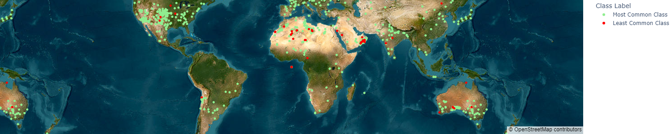
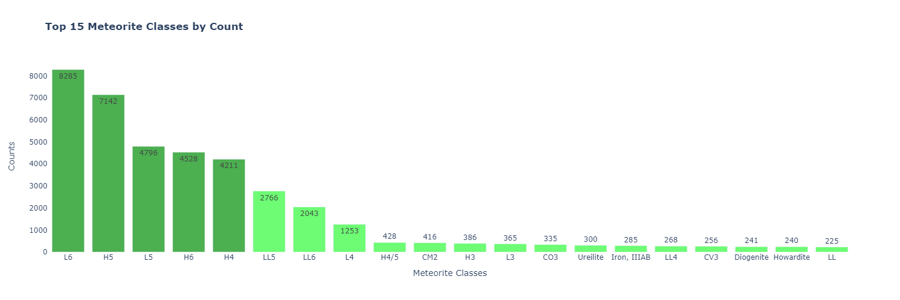
Most common classes & Least common classes
L6 & H5 class most commonly found because they are present in higher numbers in asteroids belt as well as their parents are large ( > 100km in diameter) and capable of sending large no. of fragments to Earth
Notes:
Green colour is most common type of meteorite class these are L6/H5, there are many least common types these are labelled in red colour for eg. EL7, CH,CBb. We found out that L6 & H5 class are most commonly found in the dataset because they are present in higher numbers in asteroids belt as well as their parents are large ( > 100km in diameter) and capable of sending a large no. of fragments to Earth. As most of the asteroids burn off in Earth’s atmospheric layers, the larger parent asteroids, have higher probability of reaching Earth.
Extra part:-
Regarding their location, L6 meteorites, like other chondrites, are believed to come from the asteroid belt. This region is located between Mars and Jupiter and contains a large number of objects that can potentially collide with Earth. The commonality of L6 meteorites is likely due to a combination of factors, including the size and collisional history of their parent body in the asteroid belt, their robustness which allows them to survive the passage through Earth's atmosphere, and the frequency with which their orbits intersect with Earth's.

Slide 8
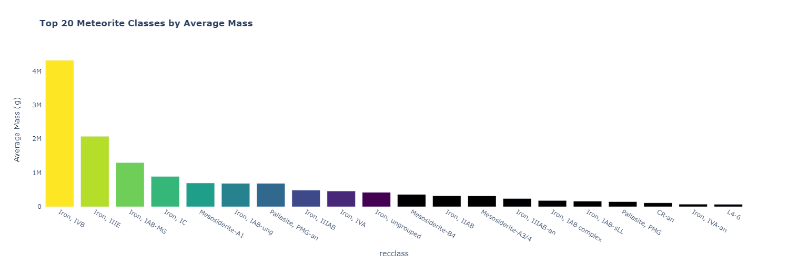
Classes based on Average Mass
“Iron, IVB” with very high average mass is because of it’s composition of iron, which is very dense and heavy metal
High density is equivalent to large mass for their size
Others are mostly stony meteorite with lesser density
Notes:
Compared to other meteorite classes, the average mass of the "iron, IVB" class is notably high, at approximately 4,323 kilograms. this class of meteorites is primarily composed of iron, which is a dense and heavy material. This high density means that iron IVB meteorites can have a relatively large mass for their size, especially when compared to stony meteorites that have a lower density

Slide 9



Relationship between year and fall
Notes:
Now, let’s discuss the relationship between year and fall.

Slide 10
/content/Meteorite_Landings.csv
Fell vs Found
A fell meteor is a meteor is one which we saw falling in the atmosphere and did not find
A found meteorite is one which was found on the ground.
Notes:
But first, we need to note the difference between fell and found.
A fell meteor is a meteor is one which we saw falling in the atmosphere and did not find
A found meteorite is one which was found on the ground.

Slide 11
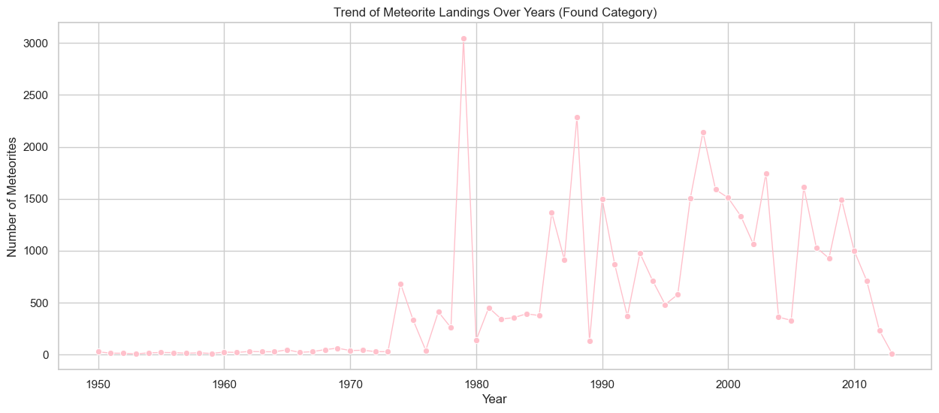
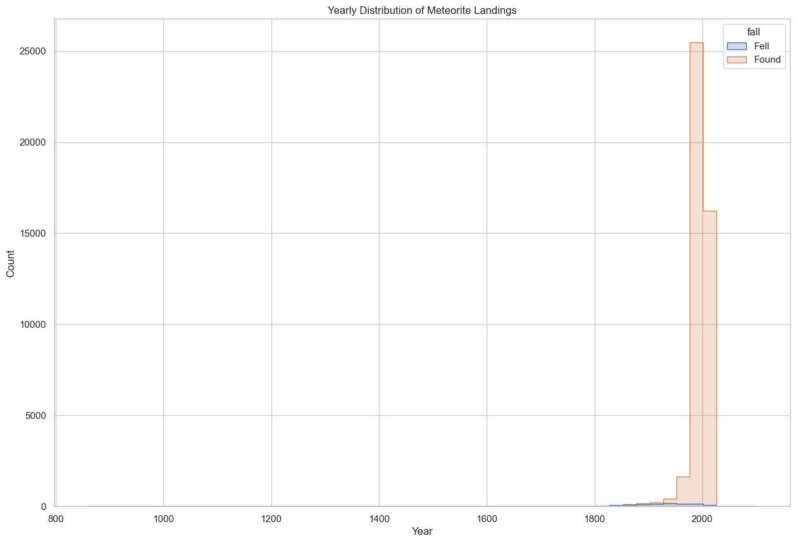
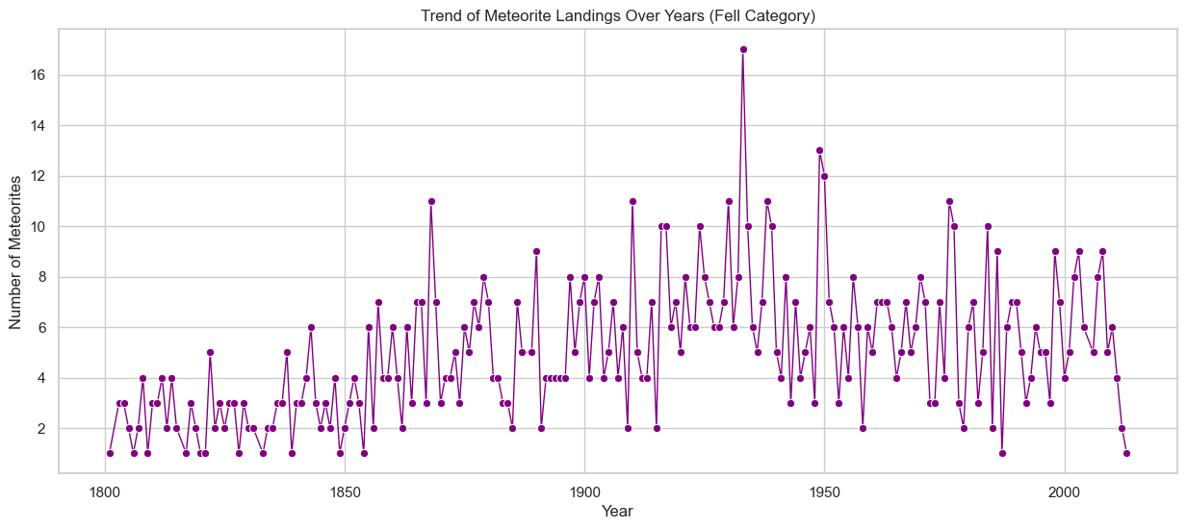
Yearly Distribution of Meteorite Landings
The increase in 'Found' meteorites over recent year could be due to improved detection methods, increased exploration, or greater scientific interest in recent years.
Notes:
This histogram has 'year' on the x-axis and counts on the y-axis, colored by 'fall' category, this reveals the distribution of meteorite landings over time. We can see that there is a small number of meteorites recorded as “fell” compared to the number of meteorites recorded as “found”. It appears that the number of meteorites recorded as 'Found' has increased markably in around 1950s but the number of meteorites recorded as “Fell” starts earlier in around 19th century but remains stable. We can see more details in this two line chart.(click twice to show the two graph )
From this ,we can infer that the increase in “Found” meteorites can be contributed to the advanced technology, and greater interest in this area.

Slide 12
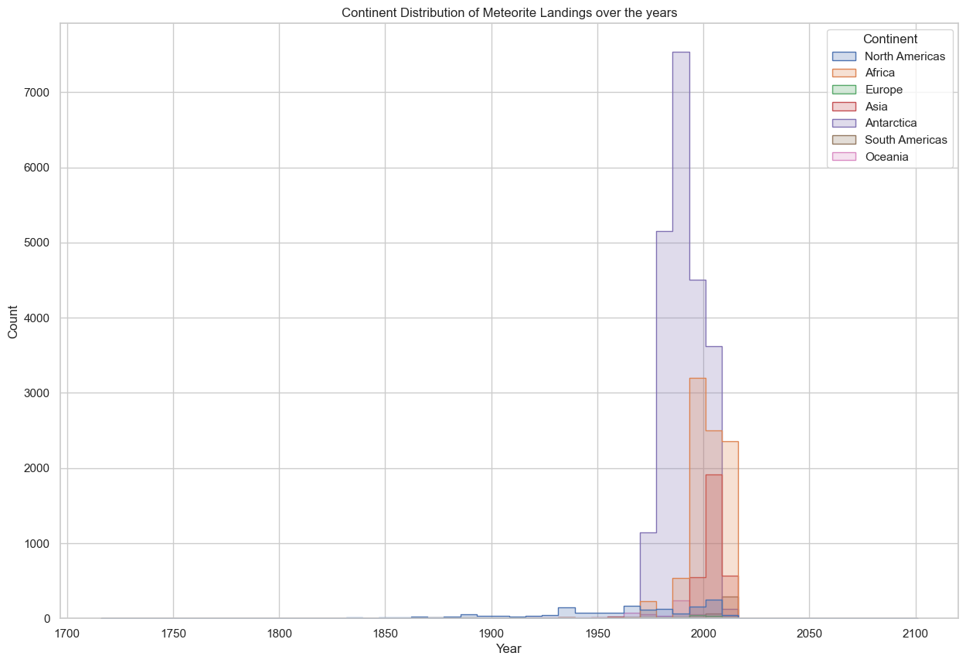
Continent Distribution of Meteorite Landings over the years
The finding of meteorites landing starts in North America firstly and remains a stable low number over the years, which could be due to the leading detection method of US and early interest in meteorite research.
The most finding of meteorites landing are in Antarctica may be due to Ice Flows and Accumulation Zones, preservation by cold and dry conditions, concentrated Search Efforts.
The sparkings of the number of meteorites Landings are concentrated from 1990 to 2000, which is due to the leap in detection technology and it decreases in the later year since most meteorites are already found.
Notes:
Here is the graph of continent distribution of meteorite landing over the years. We can see that North America is the first country to begin recording a lot of meteorites. This could be due to the fact that US has the leading detection method and the earlier interest in meteorite research.
The most finding of meteorites landing are located in Antarctica , which can be contributed to more natural factors. And meteorites in Antarctica can be preserved better by the cold and dry weather. Also many scientists went Antarctica for scientific research and exploration , which increase the chances of finding meteorites. TAKE A LITTLE TIME SO PEOPLE CAN READ
The sparkings of the number of meteorites Landings are concentrated from 1990 and 2000, which could be accounted for the leap in detection technology . And it decrease sharply in the later years since most meteorites are found during the formal time.

Slide 13
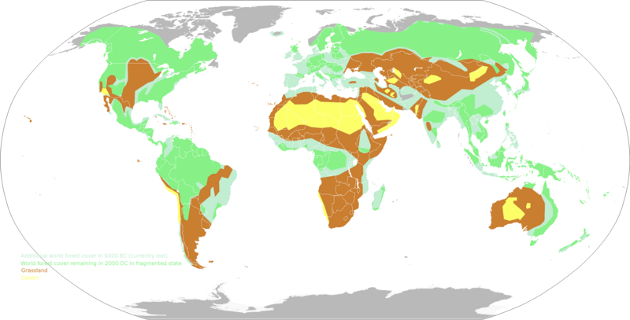
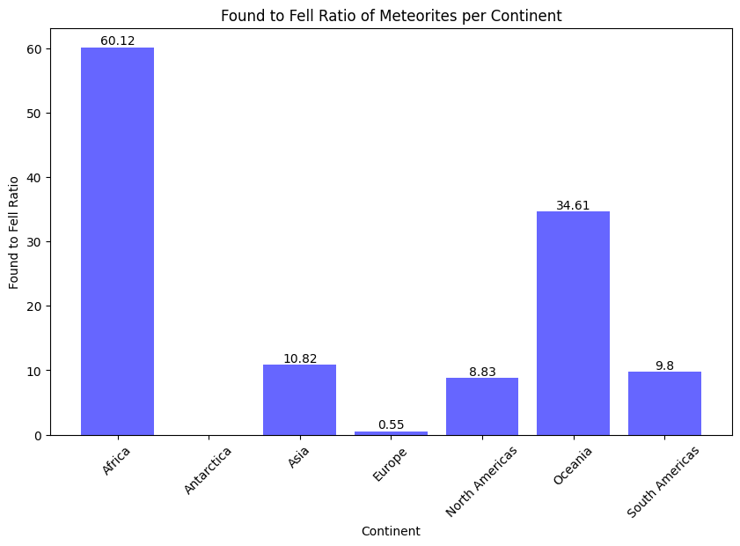
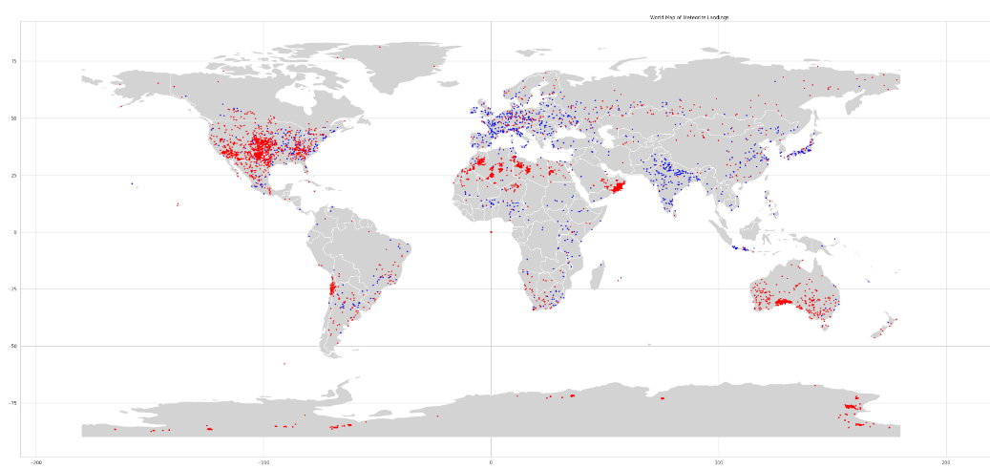

Fell vs Found:
the reasons for these differences could include the climatic conditions of the continents, geographical features, population distribution, history of scientific research and meteorite search activities, as well as the local level of interest in meteorite events.
Notes:
As we can see africa australia and antarctica have the highest fell to found ratio. As we can see above Africa Oceania have huge deserts where a majority of the meteorites are found. The above map doesnt show but antarctica is the largest desert on the planet and all meteorites there have been found none have been classified as fell, this is most likely due to the fact that to live on antarctica you need alot of technology which makes it much easier to find meteorites and antarctica is a place for exploration and research and means that most meteorites are found as they are much easier to see against a whiter landscape.

Slide 14
Dear Meteorite Hunters
The key takeaway of our project, don’t hunt for meteorites in the ocean
Thank you!

Slide 15
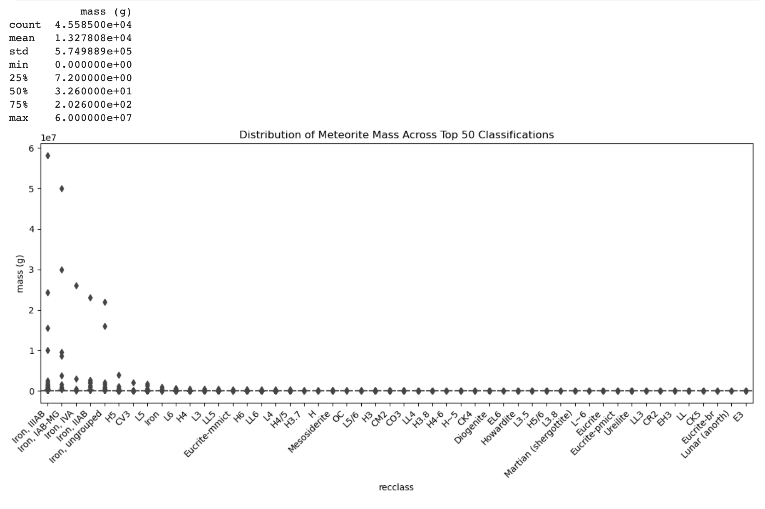
Mass Variation
Notes:
Here, we see the distribution of the top 50 classifications. The x axis is the class and y axis is the mass in grams. The average mass in the dataset is 12,300 grams.

